Slide 1
Autothon 2019
Team AutoReign

Slide 2
Problem Statement 1
Application under test (AUT) for automation is a movie rental portal
Need to automate the following tests as part of first release:
1. UI: Adding a new movie
2. UI: Data Driven Login
3. UI: Two parallel browser sessions
4. API (+ UI optional): Data Driven movie creation via API

Slide 3
Test Automation Strategy
Automation process strategy—
Tools, Technology & Interfaces Used for Automation, Performance and CI/CD
In-scope and Out of Scope Analysis
Resources Needed
Data base used- MS SQL Server, Oracle
Release plan
Breakpoints Targeted- Desktop, Mobile and Tablet
Infrastructure & Environment set up

Slide 4
Tools & Interfaces Used
1- Interfaces Used- API, UI, Mobile
2- Framework Used- Page Object Model
3- Scripting language- Java
4- Test Configuration Tool- TestNG
5- Build management Tool- Maven
6- Version Control Tool- GIT
7-API Tool- Rest Assured, PostMan
7- Reporting Tool - Extent Reports
8- JARs- Selenium, Maven Sure fire, Rest Assured, Apache POI

Slide 5
Solution proposed for Release 1
Since Application under Test is scalable, dynamic and for multiple user types, we have proposed following solution–
Test scripts written in eclipse IDE using Selenium Web driver and TestNG
Extraction of data from excel sheets using Apache POI APIs
TestNG annotations, XML, Xpath expressions and other locators for inspecting document object model of Web applications
Used version control tool Git
Incorporated parallel execution via TestNG
README file for brief project details

Slide 6
Problem Statement 2
Mobile App will be released (React Native App) for iOS and Android with same features as into web app
Tablets and mobile phones are to be targeted
Mobile app users to get voucher for extra movie
Due date notifications for return deadlines
Barcode scanner
Data ware house and Reporting
Streaming

Slide 7
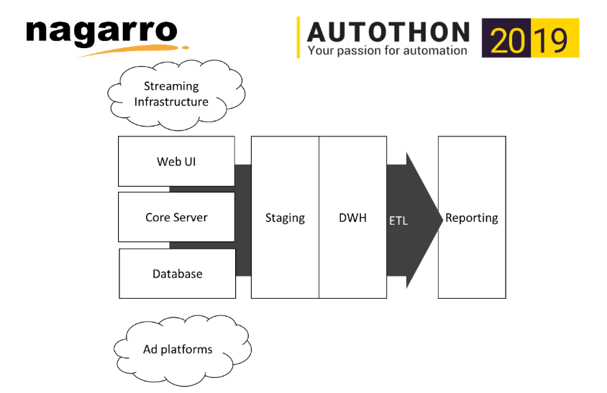
Data Warehouse & Reporting

Slide 8
Proposed Solution to Change of Requests
Other tools like- Android SDK, Appium to be used for Mobile App Testing
Enhance first user login code so that user can avail voucher
Due date notification code to be incorporated
Scanning a barcode/QR code to be added
Authentication for request counter and move name match with data base MS SQL or Oracle
Use Apache PDF package for export PDF and SVG
Inbuilt Reporting
Out of Scope-
A dynamic way of building your own reports
Transcoding to different format

Slide 9
Automation Approach for new Component
Components can be automatically tested in an integrated way
1.From a CI/CD perspective- Jenkins Server
2. Test data management point of view- Excel as data provider
3. Reusability across systems and test levels- Reusable components like Wrapper classes, pages, Constructors, TestNG
Reusable components-
After method-Take Screenshot, Browser closure
Before method- Launch browser, Initialization,

Slide 10
Proposed Solution for Release 2 challenges
We need international help from the other geographies as-
The DWH experts are in the Nordics and Romania
The payment experts are in the US and Germany
The streaming experts are in Singapore and Austria
The mobile experts are in India
In order to fulfill that, we need a Continuous Integration and Development environment tool like Jenkins for synchronized code build, development, merge and test activities.
Existing strategy aspect can also be merged with CI/CD tool Jenkins to give a solution to this problem statement so that experts can integrate code into a shared repository several times a day

